Slide 1
Exchange and Sharing
2023/9/3
Xu Guo

Slide 2
directory
Learned
Work
Summary

Slide 3
Learned

Slide 4
Tools
1.C-ATS
2.spec2script test_spec.xls
3.FileGather
FileGather.exe -p scripts -w id.txt
4.Gauss
gauss.exe -f exporter -i script_ids.txt
5.GMVehicleSimulator /lovelace
PowermodeSimulator
Power_Mode_Simulator_GB.exe start-server -pl MY23_VCS -p Propulsion -g P
6.SVTool
7.Tera Term/remote_term

Slide 5
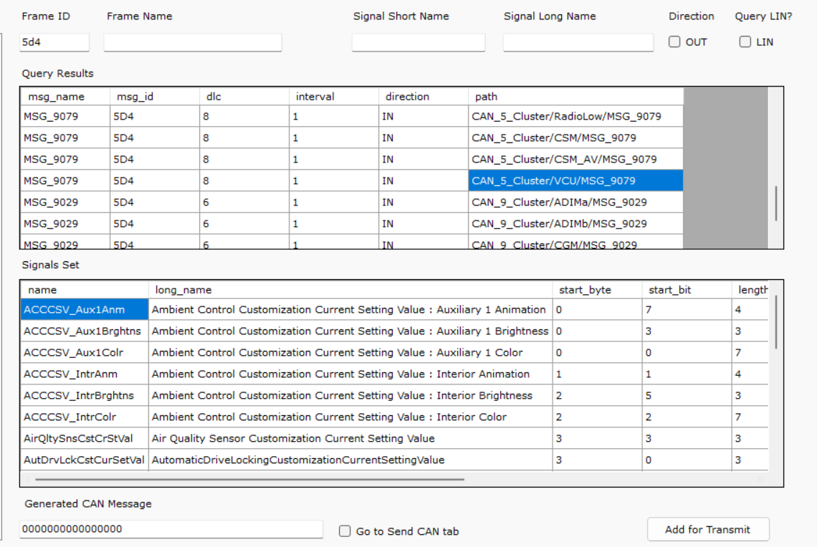
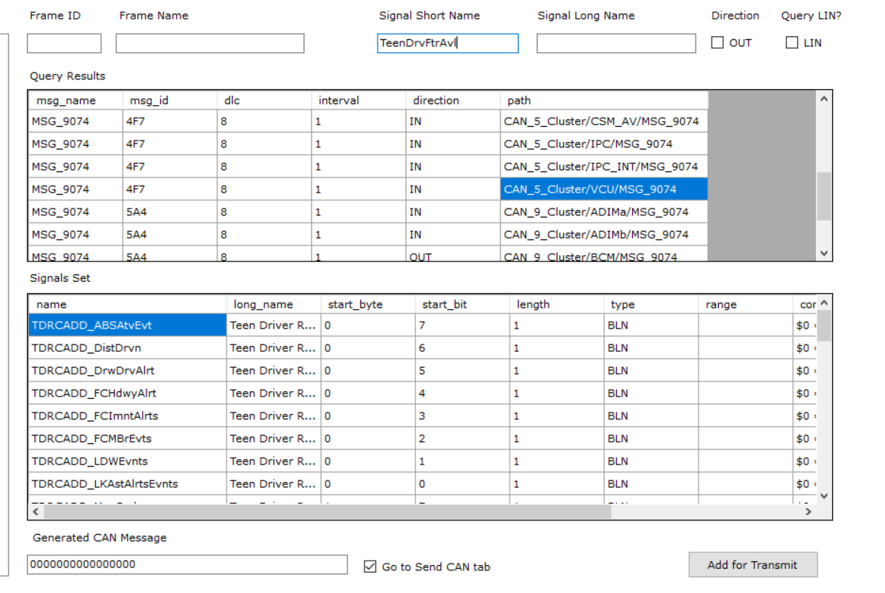
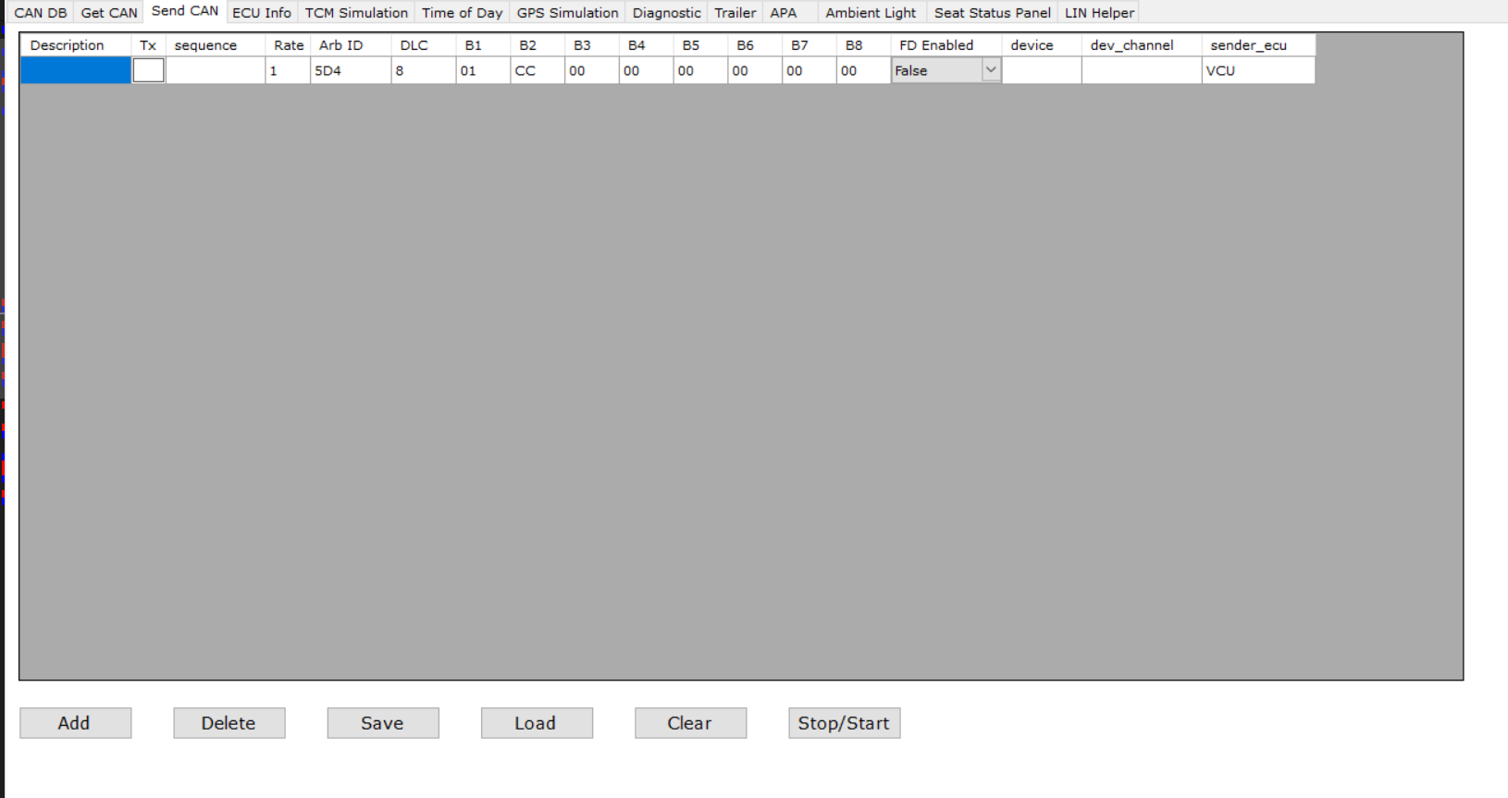
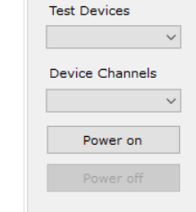
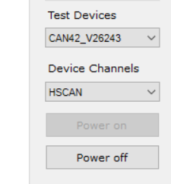
SVTool

Slide 6
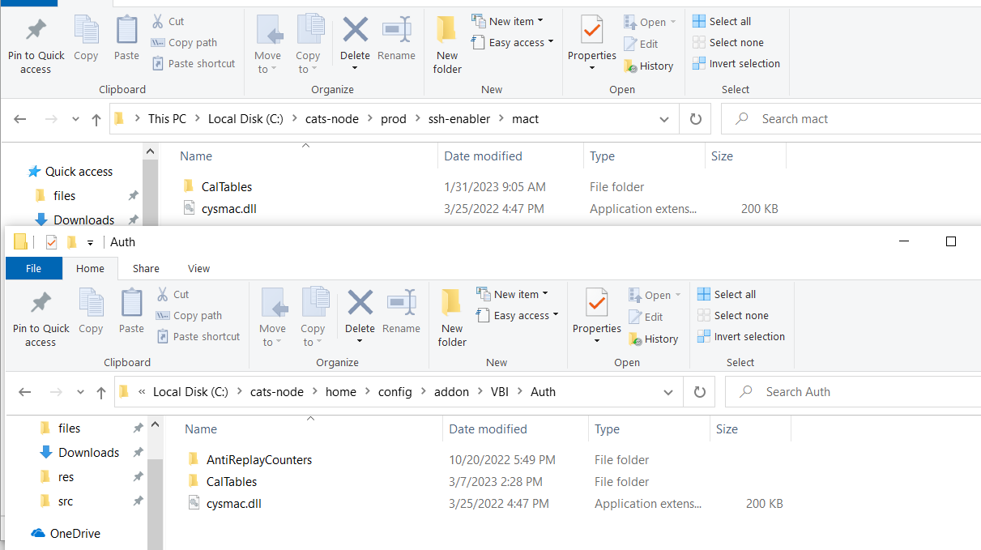
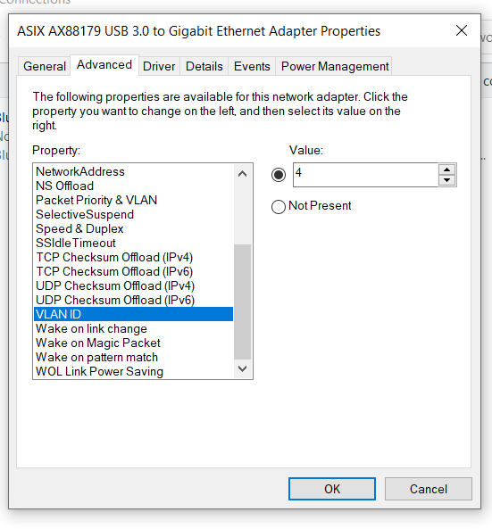
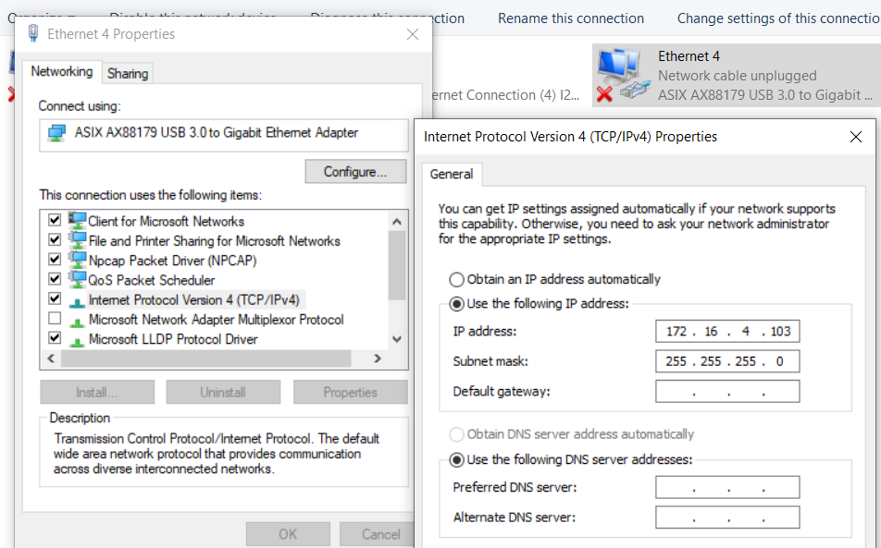
Techniques
test environment setup（HW/SW）
Android: USB connect 2.0/3.0
Cluster/HUD/QNX: 网线/双USB SSH
配置 IP:TCP/IPv4 VLAND ID :4

Slide 7
2. flash_VCU (Manual/Auto)
Maybe USB bad?
硬件没刷进去：
echo '
[/diag_config/config.reg]
"HW_ConfigPartNumber"=hex:00,31,00,16,00,00,00,00' > /diag_config/config.reg
override文件未刷进去

Slide 8
Work

Slide 9
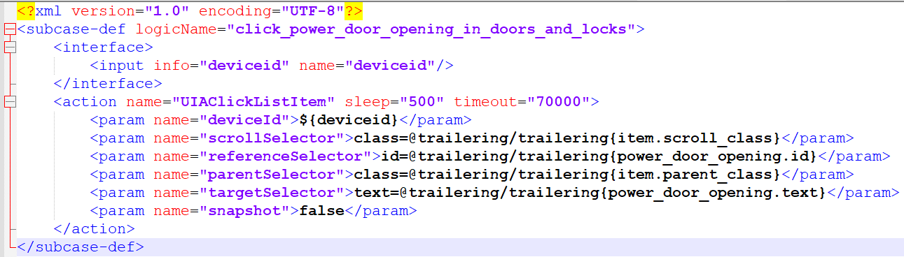
Creation
case 中subcase飘红：soft links/Git repository not pull
ACTION SendCANMSG2 [finished] result=Error, duration=0'00".799 sec returnValue= errorCode=2031 errorMessage=Failed to parse the CAN signal(s) because the CAN data file (.json) is missing or the configured CAN data file doesn't exist.
notices:
1.subcase ,casevar,inages 命名
verify_customize_select_in_ ambientLighting
mfc_verify_customize_select_in_ ambientLighting
subcase ,casevar,inages名字必须一致，但是images和casevar不加verify
2.验证点
尽量使用text，id
3.casevar中的信号
新增message和signal在不同文件中
4.UIAClickListItem

Slide 10
发速度，切换档位：
<subcase path="can_subcase/vehicle_info/canopr_sendmsg_send_speed_and_forward_gear_pmsimulator">
<param name="speed">1</param>
<param name="speed_duration">60000</param>
</subcase>
<operation path="common/can/canopr_sendmsg_vehicle_park"/>
<operation path="common/can/canopr_sendmsg_vehicle_forward"/>
<operation path="common/can/canopr_sendmsg_vehicle_reverse"/>
汽车状态：
Off，Acc，Crank，Run，Propulsion
汽车档位：
Drive，Park，Neutral，Reverse，Low(ICE)

Slide 11
Summary

Slide 12
1.Summary
2.Future Planning

Slide 13
Thanks
Speaker
Xu Guo

